Slide 1
Safeguarding Children Induction for Adults Working or Volunteering in Schools
Produced by Gloucestershire Safeguarding Education Partnership – Sept 2020
Notes:
It is recommended that staff receive this induction within the first week of starting at the school. They should receive the quick reference guide on their first day in the event that they have a concern about a child.
It is suggested that the DSL has copies of the school child protection policy, the behaviour policy, the staff behaviour policy (sometimes called the code of conduct), Guidance for Safer Working Practice for Adults who work with Children and Young People (2019 version), Safeguarding Quick Reference Guide and Keeping Children Safe in Education guidance (DfE 09.2020). The safeguarding response to children who go missing from education and the role of the DSL (including identity of the DSL and any deputies).
Staff should also read Working Together to Safeguarding Children (June 18).
A record of induction for new staff/volunteers should be maintained by the DSL for auditing and inspection purposes.

Slide 2
Aim
To provide a safeguarding induction for newly appointed staff, supply staff, school volunteers/helpers and students on placement, which will raise the awareness of:
how to recognise indicators of abuse
how to report safeguarding concerns about a child and to whom
Know how to make a referral
safe working practice by adults in school
have an awareness of Early Help processes and understand their role in it
Notes:
Section 175 (Section 157 if Independent School) of the Education Act 2002 places a legal duty on local authorities and governing bodies to safeguard children.
Schools are required by the Secretary of State to provide staff with a safeguarding children induction, followed up by safeguarding children training.
Staff in schools are well placed to recognise, often early on, the indicators that a child’s needs are not being met. If staff recognise and report concerns, this can sometimes mean that early intervention can prevent abuse from happening. If staff don’t know how to recognise and report concerns, children can be left at risk of harm.
Part of the safeguarding children agenda is about making sure that all those who work with children in school, are safe, competent and confident to do so. Staff need to know how to work in a safe, appropriate way with children. Safe, professional conduct safeguards children and staff.

Slide 3
Safeguarding
Safeguarding and promoting the welfare of children is defined as:
protecting children from maltreatment
preventing impairment of children’s health or development
Ensuring that children grow up in circumstances consistent with the provision of safe and effective care
Taking action to enable all children to have the best outcomes
Working Together to Safeguard Children (DfE 2018)
Notes:
Everyone who works with children has a responsibility for keeping them safe. No single practitioner can have a full picture of a child’s needs and circumstances and, if children and families are to receive the right help at the right time, everyone who comes into contact with them has a role to play in identifying concerns, sharing information and taking prompt action.
Protecting children from abuse is important in preventing the impairment of health or development though that in itself may be insufficient to ensure that children are growing up in circumstances consistent with the provision of safe and effective care.
As well as threats to the welfare of children from within their families, children may be vulnerable to abuse or exploitation from outside their families. These extra-familial threats might arise at school and other educational establishments, from within peer groups, or more widely from within the wider community and/or online. These threats can take a variety of different forms and children can be vulnerable to multiple threats, including: exploitation by criminal gangs and organised crime groups such as county lines; trafficking, online abuse; sexual exploitation and the influences of extremism leading to radicalisation. Extremist groups make use of the internet to radicalise and recruit and to promote extremist materials. Any potential harmful effects to individuals identified as vulnerable to extremist ideologies or being drawn into terrorism should also be considered.

Slide 4
Categories of Abuse
Physical Abuse
Causing physical harm to a child
Neglect
Persistent failure to meet a child’s needs – physical
and/or psychological
Sexual Abuse
Involving a child in sexual activity
Emotional Abuse
Persistent emotional ill treatment of a child
Notes:
Physical abuse: a form of abuse which may involve hitting, shaking, throwing, poisoning, burning or scalding, drowning, suffocating or otherwise causing physical harm to a child. Physical harm may also be caused when a parent or carer fabricates symptoms of, or deliberately induces illness in a child.
Neglect is the persistent failure to meet a child’s basic physical and/or psychological needs, likely to result in the serious impairment of the child’s health or development. Neglect may occur during pregnancy as a result of maternal substance abuse. Once a child is born, neglect may involve a parent or carer failing to : provide adequate food, clothing and shelter (including exclusion from home or abandonment); protect a child from physical and emotional harm or danger; ensure adequate supervision (including the use of inadequate care-givers); or ensure access to appropriate medical care or treatment. It may also include neglect of, or unresponsiveness to, a child’s basic emotional needs.
Sexual abuse involves forcing or enticing a child or young person to take part in sexual activities, not necessarily involving a high level of violence, whether or not the child is aware of what is happening. The activities may involve physical contact, including assault by penetration (for example, rape or oral sex) or non-penetrative acts such as masturbation, kissing, rubbing and touching outside of clothing. They may also include non-contact activities, such as involving children in looking at, or in the production of, sexual images, watching sexual activities, encouraging children to behave in sexually inappropriate ways, or grooming a child in preparation for abuse (including via the internet). Sexual abuse can take place online, and technology can ve used to facilitate offline abuse. Sexual abuse is not solely perpetrated by adult males. Women can also commit acts of sexual abuse, as an other children. The sexual abuse of children by other children is a specific safeguarding issue in Education (see part 5 of KCSiE)
Emotional abuse is the persistent emotional maltreatment of a child such as to cause severe and adverse effects on the child’s emotional development. It may involve conveying to children that they are worthless or unloved, inadequate, or valued only insofar as they meet the needs of another person. It may include not giving the child opportunities to express their views, deliberately silencing them or ‘making fun’ of what they say or how they communicate. It may feature age or developmentally inappropriate expectations being imposed on children. These may include interactions that are beyond the child’s developmental capability, as well as overprotection and limitation of exploration and learning, or preventing the child participating in normal social interaction. It may involve seeing or hearing the ill-treatment of another. It may involve serious bullying (including cyberbullying), causing children frequently to feel frightened or in danger, or the exploitation or corruption of children. Some level of emotional abuse is involved in all types of maltreatment of a child, although it may occur alone.
DSL to expand upon the possible indicators of each category.

Slide 5
Safeguarding Role of School Staff
Recognise 
Respond 
Investigate x
Attempt to resolve x
Notes:
SAFEGUARDING ROLE OF SCHOOL STAFF
Recognise ✓
Staff need to recognise when they are concerned about a child. Being able to recognise concerns, means being familiar with the indicators of abuse
Respond ✓
Staff must respond to a concern about a child by passing the information to their Designated Senior Lead (DSL) or Deputy DSL without delay. Staff must then make a written record of their concern as soon as possible and pass this to the DSL.
Investigate ✗
Staff are not responsible for investigating concerns about a child. Investigating includes in depth questioning of a child, colleagues, parents, physically examining children, taking photographs of injuries. Investigating does not mean that staff cannot talk to a child, colleagues or parents, but it is important that this is done in a non-leading way that would not compromise any formal investigation.
Attempt to resolve ✗
Staff should not attempt to resolve the situation themselves e.g. make and act upon decisions about how they think the matter should be dealt with. This kind of action fails to take account of any other information that may be held about the child e.g. other concerns of which the DSL is aware.

Slide 6
Talking and Listening to Children
Do Not:
Investigate
Try to resolve
Promise confidentiality
Make assumptions
Do:
Be approachable
Listen carefully, uncritically
and at the child’s pace
Take what is said seriously
Clarify essential information
Reassure
Tell the child what will happen next
Tell the Designated Senior Lead without delay
Record
Notes:
Listening openly to children is at the heart of safeguarding and promoting children’s well-being and protection. It covers a whole range of behaviours and situations.
It starts with an ethos in school which helps children to feel safe and able to talk.
Listening isn’t the simple process we might think it is. Children often drip feed us information and test us out to see if we can hear and if they will be believed
We all have our own filters but some we should be aware of are those around race, culture, class and myths around disability.
So we need to be approachable
Listen carefully, uncritically and at the child’s pace
Take what is said seriously
Clarify essential information
Reassure
Tell the child what will happen next
Tell your DSL without delay
And what we mustn’t do is
Investigate
Try to resolve
Promise confidentiality
Make assumptions
Importance of listening to children and taking what they say seriously – not staff’s place to make judgements about the validity or truth of what they are hearing.

Slide 7
Recording
Child’s name and date of birth
Date and time of the concern
Factual account of what happened, where and who was present using the child’s own words
Any opinion / interpretation needs to be explained
Your response
Printed name and signature of person making the record
Job title of person making the record
Date and time of the record
Notes:
Provide the member of staff with the school’s own arrangements for raising a concern and talk them through this. Ensure they are aware that concerns should be reported without delay. (to ensure that Social Care have the maximum possible time to see the child before going home after school).
Factual account:
nature of the concern
where the information came from
if the child has an injury where is it, what does it look like, does the child appear in pain
child’s account in their own words, method of communication
other’s accounts
witnesses
questions asked of child and/or others
what action was taken by you or others

Slide 8
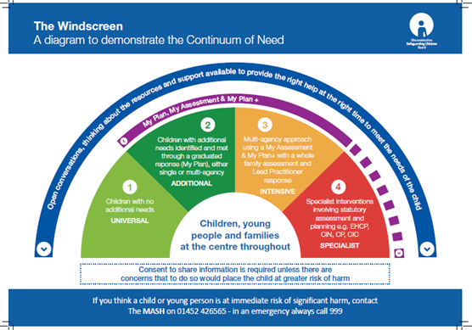
Early Help
What does the settings offer of Early Help look like?
Levels of Intervention – www.gscb.org.uk
Notes:
Any child may benefit from early help, but all school and college staff should be particularly alert to the potential need for early help for a
child who:
is disabled and has specific additional needs;
has special educational needs (whether or not they have a statutory education, health and care plan);
is a young carer;
is showing signs of being drawn in to anti-social or criminal behaviour, including gang involvement and association with organised crime groups;
is frequently missing/goes missing from care or from home;
is misusing drugs or alcohol themselves;
is at risk of modern slavery, trafficking or exploitation
If early help is appropriate, the DSL or deputy will generally lead on liaising with other agencies and setting up an inter-agency assessment as appropriate. Staff may be required to support other agencies and professionals in an early help assessment, in some cases acting as the lead professional. Any such cases should be kept under constant review and consideration given to a referral to children’s social care for assessment for statutory services, if the child’s situation does not appear to be improving or getting worse.
Go through the Levels of Intervention with staff.

Slide 9
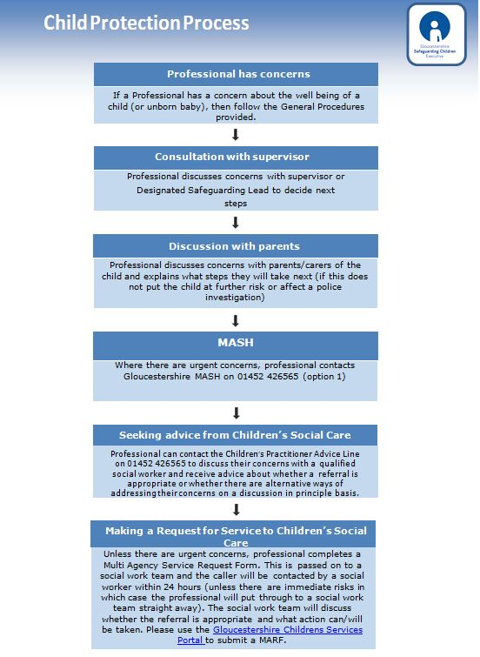
Notes:
Talk through the CP process including staff’s responsibility to make a referral.
The DSL or deputy should always be available to discuss safeguarding concerns. If in exceptional circumstances, the DSL or deputy is not available, this should not delay appropriate action being taken. Staff should consider speaking to a member of the SLT and/or take advice from local children’s social care. In these circumstances, any action taken should be shared with the DSL or deputy as soon as this is practically possible.

Slide 10
Safe Working Practice
All staff should clearly understand the need to
maintain appropriate professional boundaries
in their dealings with young people.
An ongoing culture of vigilance should be maintained
within schools so that poor or unsafe practice is
identified at the earliest opportunity.
Notes:
DSL to advise member of staff about the ethos of the school and the expectations on staff about safe and appropriate professional conduct.
Also how poor, unsafe and unprofessional conduct is dealt with.
Refer them to the Guidance for Safer Working Practice for Adults working with Children and Young People (2019).

Slide 11
Safe Working Practice
Key documentation in schools:
Safeguarding policies (child protection, safer recruitment, anti bullying, whistle blowing, e-safety and physical intervention, behaviour policy,)
The staff behaviour policy (sometimes called the Code of conduct
Staff handbook
Seek guidance from the senior leadership team.
Notes:
Ensure that the member of staff is aware of these documents and how to access them.

Slide 12
Areas of Staff Vulnerability
Physical contact
Control and physical intervention
Communication with a child, including e-safety
Intimate/personal care
One to one situations
Relationships
Notes:
Explain to the member of staff what some of the risks might be and what is expected in terms of staff conduct.
Be very clear about staff/pupil boundaries.

Slide 13
Allegations Management
This should be used in respect of all cases in which it is
alleged that a person working or volunteering with
Children has:-
Behaved in a way that has harmed a child, or may have harmed a child;
Possibly committed a criminal offence against or related to a child; or
Behaved towards a child or children in a way that indicates he or she may pose a risk of harm to children.
behaved or may have behaved in a way that indicates they may not be suitable to work with children
Seek Early Advice – don’t investigate alone.
Involve Governors if against HT
Working Together 2010 Appendix 5.
Notes:
The process followed comes directly from the Government’s Statutory Guidance ‘Working Together to Safeguard Children 2006’ updated in 2010, 2013, 2015 and 2018. The South West have adopted the processes laid out in the 2010 version which can be found on the GSCE website www.gscb.org.uk on the South West Procedures link. This provides the framework for managing cases where, if the allegation is true, the person has:-
Behaved in a way that has harmed a child, or may have harmed a child;
Possibly committed a criminal offence against or related to a child; or
Behaved towards a child or children in a way that indicates he or she may pose a risk of harm to children.
Added in KCSiE 2020: ‘behaved or may have behaved in a way that indicates they may not be suitable to work with children’ – this refers to behaviour outside of school that could impact on their suitability to work with children
Refer them to the Quick Reference Leaflet
Keeping Children Safe in Education (p50, Part 4)

Slide 14
Key Principles
The welfare of the child is paramount.
Staff should:
Be responsible for their behaviour
Avoid conduct which would raise concern
Work in an open and transparent way
Discuss concerns / take advice from a senior member of staff
Apply the same professional standards regardless culture disability gender, language racial origin religious belief / or sexual identity.
Monitor and review practice
Follow guidance

Slide 15
Further Information
Available on the Gloucestershire Safeguarding
Children Executive website www.gscb.org.uk
South West Procedures
Female Genital Mutilation – Leaflet
Child Sexual Exploitation – Screening Tool
Guidance for Professional Challenge
Notes:
On the GSCB website they will find a wealth of information.

Slide 16
Next steps……….
Notes:
Staff member to read the school child protection policy and discuss any queries
DSL to provide staff member with a copy of/details of how to access Guidance for Safer Working Practice for Adults who work with Children and Young People
DSL to provide ‘Safeguarding Quick Reference Guide’ (on GSCE website) – and his/her contact details
DSL to ensure the staff member/volunteer signs an induction record and signs of checklist

