Slide 1
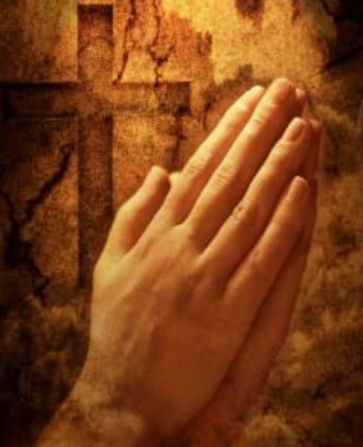
Welcome to Mrs. D'Arcy's collective worship Monday 8th February 2021

Slide 2
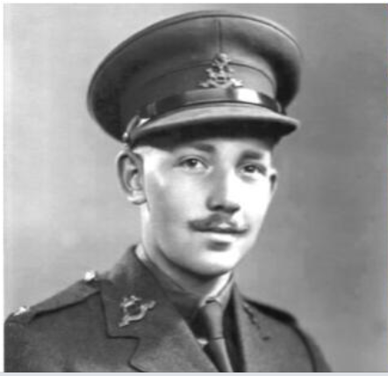
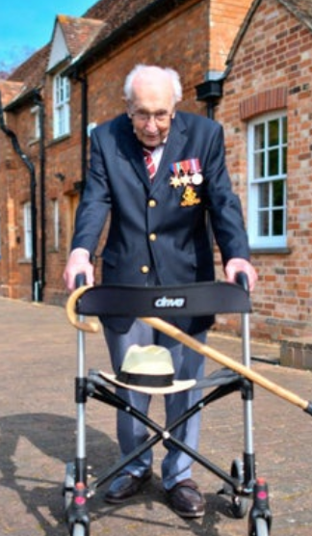
Captain sir tom moore the nation’s hero

Slide 3
You’ll Never Walk Alone

Slide 4
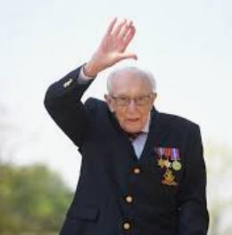
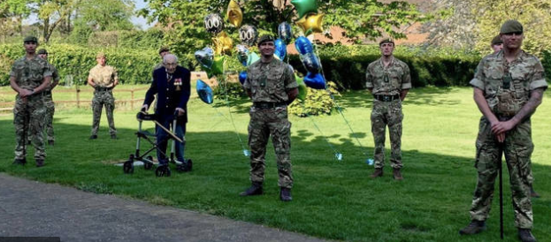
What can we learn from captain sir tom moore?
“the quality of having experience, knowledge, and good judgement; the quality of being wise”
“He was the one to make the difference. He has achieved the most astonishing thing. Not only has he raised the most incredible amount of money but he has also reminded us all that anything is truly possible,”

Slide 5
Let us pray
‘You’ll never walk alone.’

