Slide 1
Welcome to collective worship with mrs. d’arcy
WISDOM

Slide 2
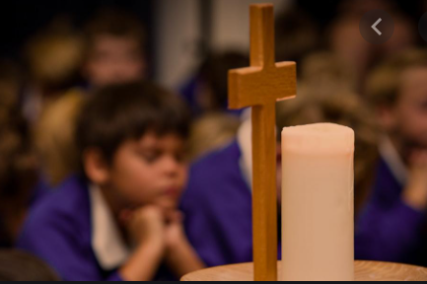
Let us move into the presence of the lord….
Hallulujah

Slide 3
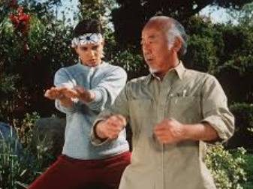
"Only root karate come from Miyagi. Just like bonsai choose own way grow because root strong you choose own way do karate same reason." - Mr. Miyagi
Karate KidKarate Kid Clip

Slide 4
You are the only possible version of you don't copy others, you have to give value to your roots, because they will be the foundations of what you can become. So strong roots, and strong foundations, equal a stronger and better you in the future if you make use of them

Slide 5
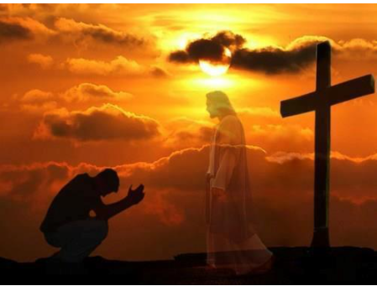
We need to build our lives on Jesus Christ, so that when trouble comes we will be able to stand firm with faith in God

Slide 6
Let’s Pray

