Slide 1
Miss Thomas’ Collective Worship
Tuesday 27th April 2021

Slide 2
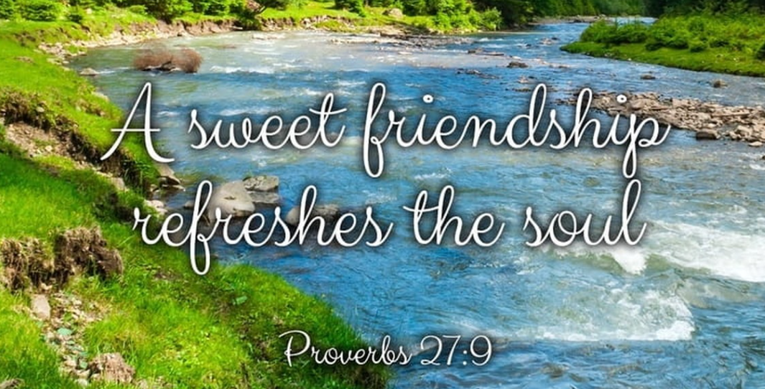
Let’s move into the presence of the lord, in the name of
God the Father,
God the Son &
God the Holy Spirit.

Slide 3
Let’s reflect…
Friendship

Slide 4
Let’s reflect…
Be ready,
Be respectful,
Be safe

Slide 5
Let’s reflect…

Slide 7
Allergy
Awareness

Slide 9
https://youtu.be/-ulwsiGR364
What can you do to help children and adults with allergies in our school or community stay safe?

Slide 10
Philippians 2:4 Each of you should look not only to your own interests but also to the interests of the others. Don’t look out only for your own interests, but take an interest in others, too.

Slide 11
Dear God,
Thank you for blessing us with friends who look out for us,
Help us to stay safe and keep one another safe.
Help us to be kind like Jesus and spread His love.
In Jesus’ Name,
Amen.

