Slide 1
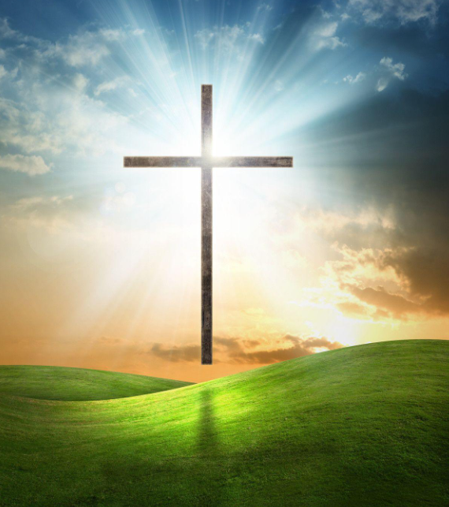
Miss Thomas’ Collective Worship
Tuesday 25th May 2021

Slide 2
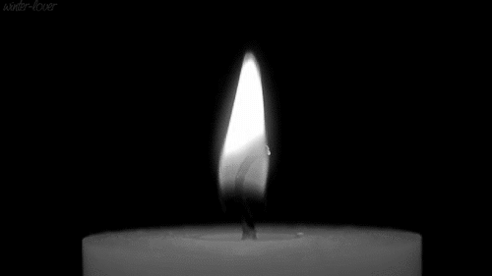

Slide 3
Mark 6: 7-13
The 12 Disciples

Slide 4
Think about a time when you worked well as part of a team with friends.
What did you and your friends do to work well together?

Slide 5
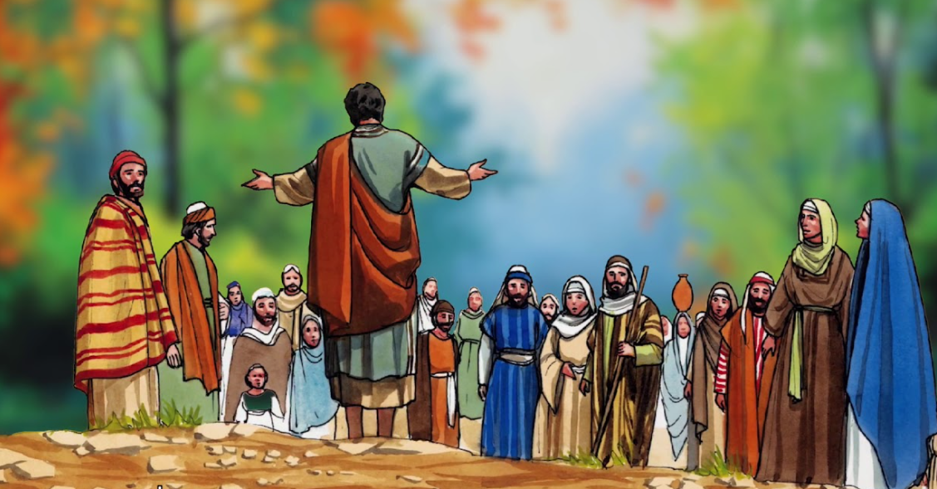

Slide 6
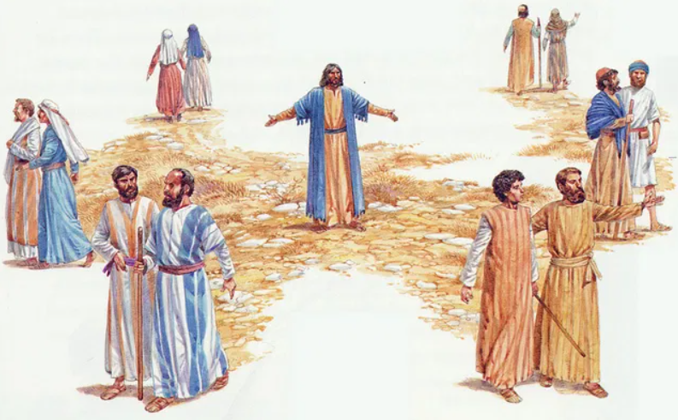

Slide 7
company
safety
protect
witness
support
friend

Slide 8
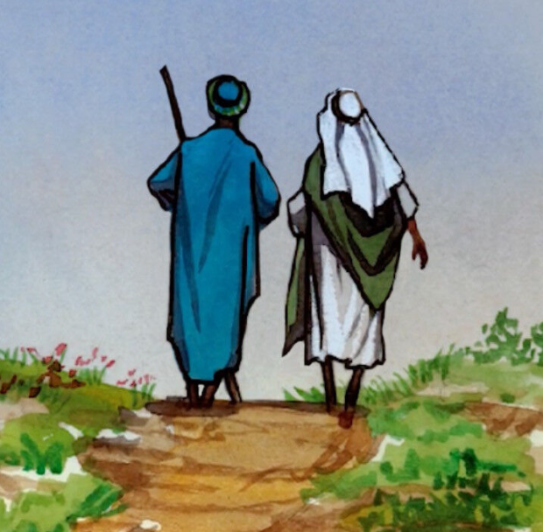

Slide 9
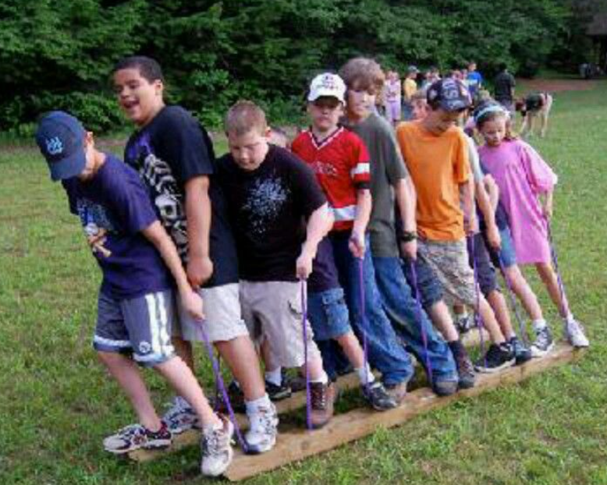
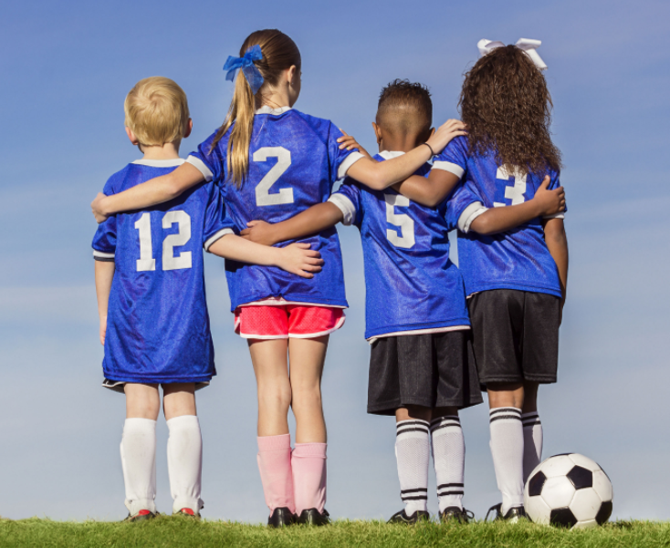
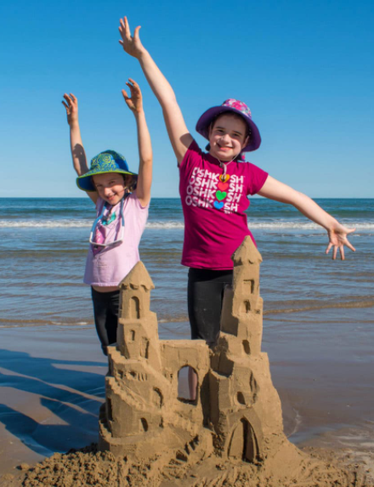
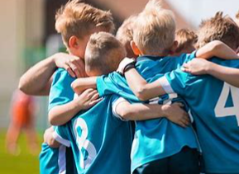
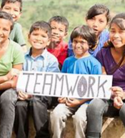
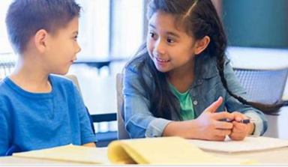

Slide 10
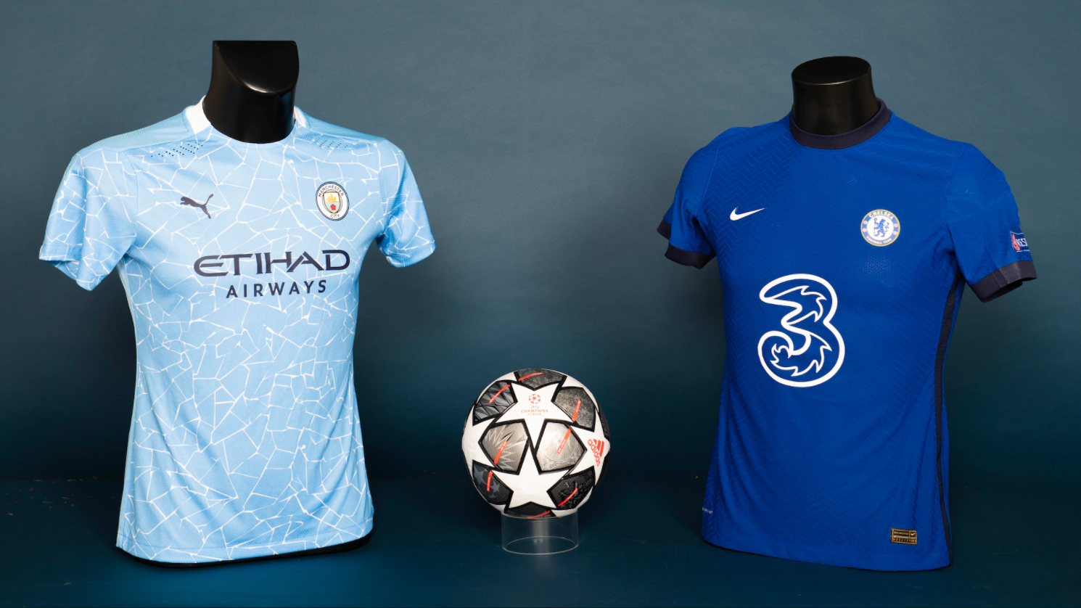

Slide 12
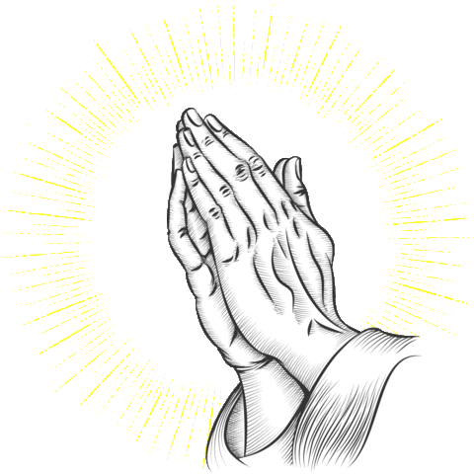

Slide 13
Dear God,
We pray that today you teach us that we can’t do everything alone.
Put people in our paths today so that we can be partners to them.
Bless our efforts so that friendship and teamwork produce more together than we could as individuals,
Amen

