Slide 1
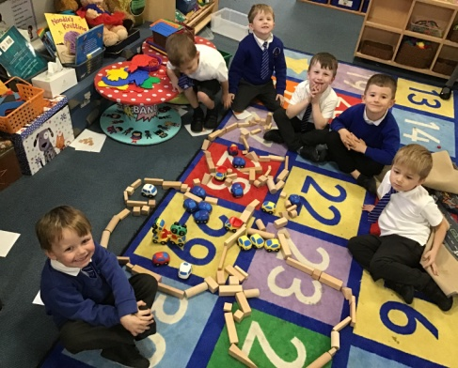
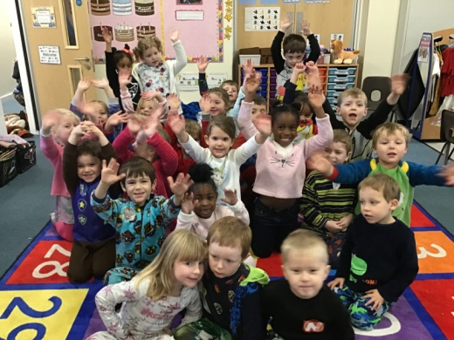
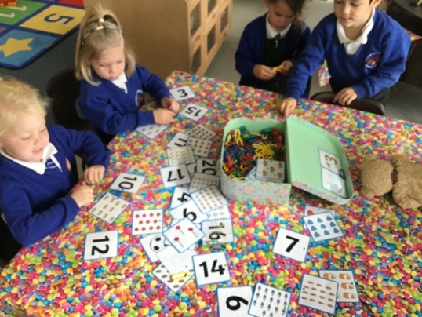
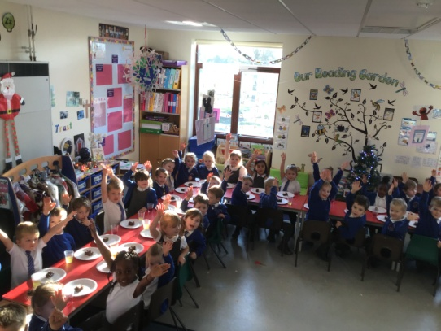
New Parents Meeting Reception (YR) 2020-21
ENGAGEMENT ENJOYMENT ENTHUSIASM = EXCELLENCE.

Slide 2
Our vision
ENGAGEMENT ENJOYMENT ENTHUSIASM = EXCELLENCE.
At Hardwicke Parochial Primary school we foster Christian principles and values so that children learn respect and empathy; they are happy and valued, healthy and safe.

Slide 3
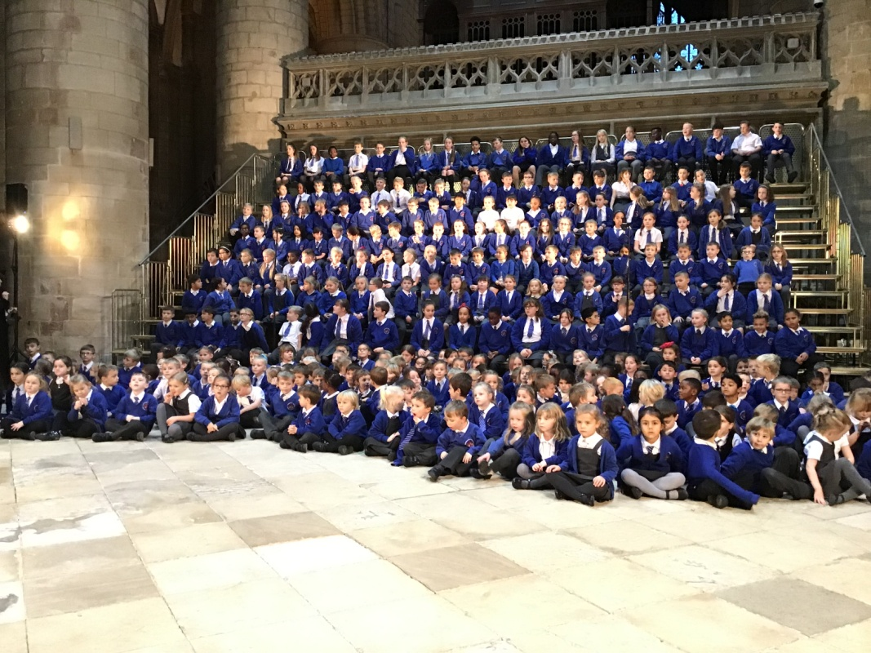
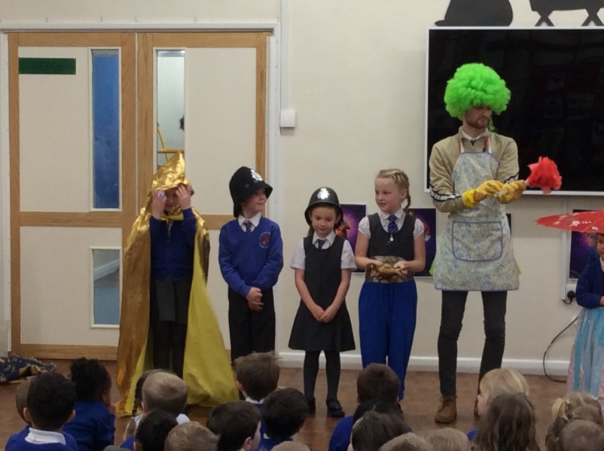
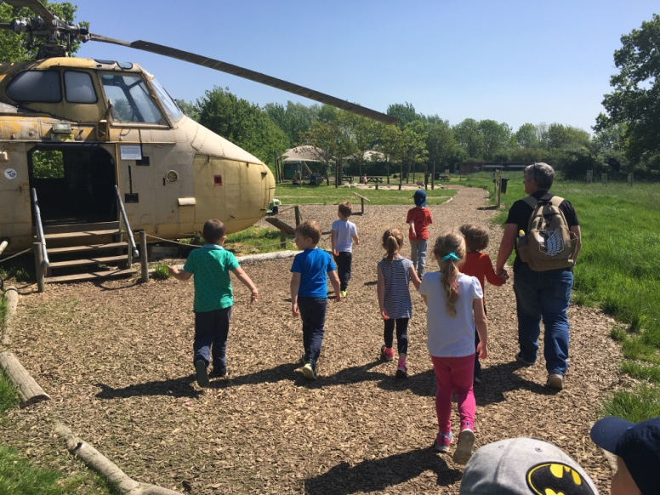
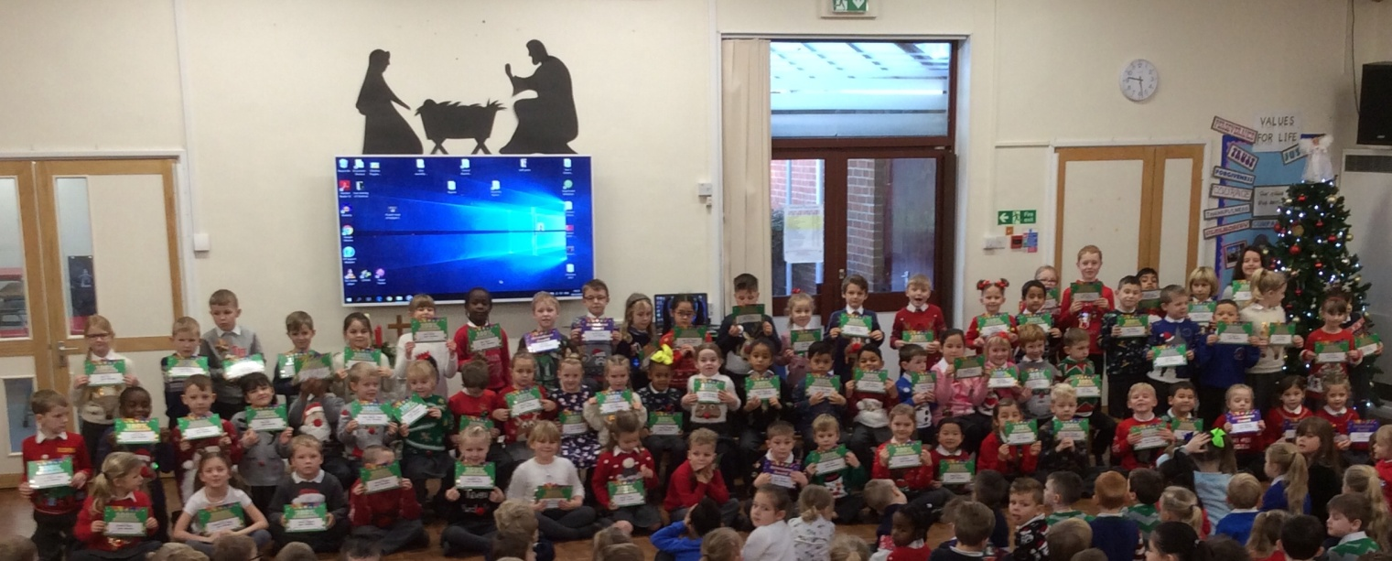
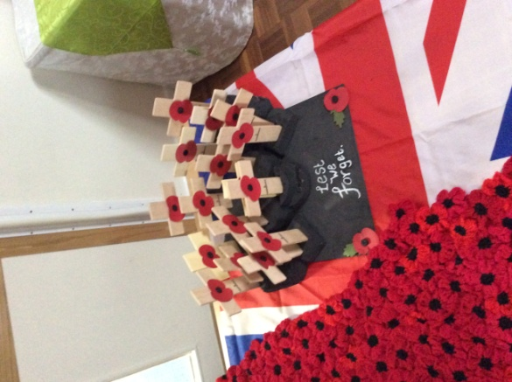
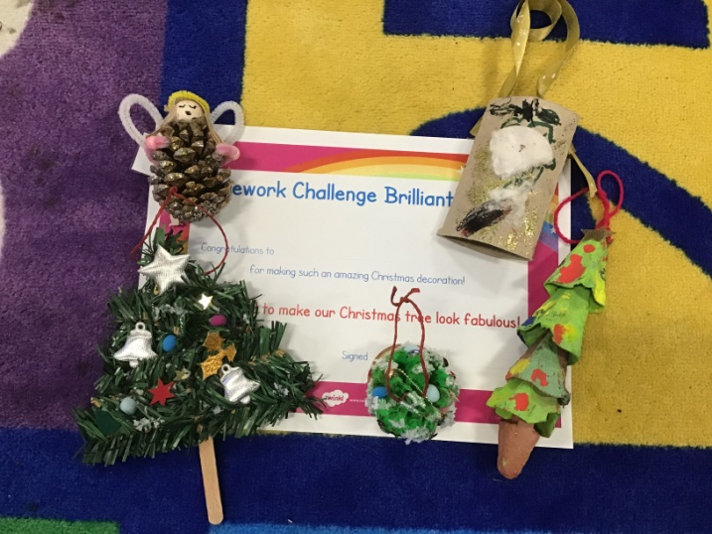
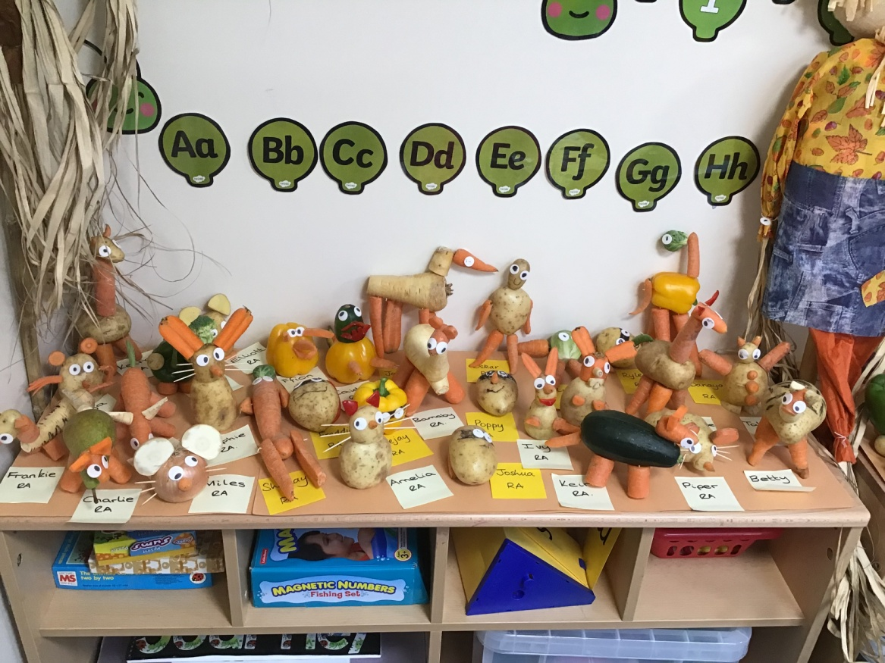
Our Vision
ENGAGEMENT ENJOYMENT ENTHUSIASM = EXCELLENCE.

Slide 4
Transition Scenario 1 Summer Term 2020
ENGAGEMENT ENJOYMENT ENTHUSIASM = EXCELLENCE.
May – EYFS teacher’s visit pre-school settings to talk with your child’s key worker and meet your child.
Early June – New parents meeting held in the school hall at 6pm. Parents will pick up information packs for your child and find out which class your child is in.
Late June – Story session at 2pm for half an hour. Parents are welcome to stay for tea or coffee in the hall.
Early July – Stay and play session 10am – 11:30am. Parents drop children off at the EYFS Foyer door and collect from the EYFS Foyer door.

Slide 5
ENGAGEMENT ENJOYMENT ENTHUSIASM = EXCELLENCE.
Starting school-Scenario 1
Week 1: Wednesday 2nd September – Individual parents meetings
Thursday 3rd September – Group A in until lunchtime (12pm)
Friday 4th September – Group B in until lunchtime (12pm)
Week 2: Monday 7th – Wednesday 9th – Group A in and stay for lunch.
Wednesday 9th – Friday 11th – Group B in and stay for lunch.
Week 3: Monday 14th – Wednesday 16th – Group A in all day.
Wednesday 16th – Friday 18th – Group B in all day.
Week 4 : FULL TIME Monday 21st September 2020

Slide 6
ENGAGEMENT ENJOYMENT ENTHUSIASM = EXCELLENCE.
Transition Scenario 2 Autumn Term 2020
May – Teachers contact Pre-school settings / parents to discuss your child.
August – Story session at 2pm for half an hour. Parents are welcome to stay for tea or coffee in the hall. (Date to be confirmed)
August – Stay and play session 10am – 11:30am. Parents drop children off at the EYFS Foyer door and collect from the EYFS Foyer door. (Date to be confirmed)
September – Individual parents meetings with class teacher

Slide 7
ENGAGEMENT ENJOYMENT ENTHUSIASM = EXCELLENCE.
Starting school-Scenario 2
Week 1: Wednesday 2nd September – Individual parents meetings
Thursday 3rd September – Group A in until lunchtime (12pm)
Friday 4th September – Group B in until lunchtime (12pm)
Week 2: Monday 7th – Wednesday 9th – Group A in and stay for lunch.
Wednesday 9th – Friday 11th – Group B in and stay for lunch.
Week 3: Monday 14th – Wednesday 16th – Group A in all day.
Wednesday 16th – Friday 18th – Group B in all day.
Week 4 : FULL TIME Monday 21st September 2020

Slide 8
ENGAGEMENT ENJOYMENT ENTHUSIASM = EXCELLENCE.
Dropping off and picking up
Day 1
EYFS foyer door opens at 8:45am and close at 8:55am.
Please bring your child into school to help them find their coat peg and settle them into their classroom.
Parents are asked kindly to leave promptly at 8:55am so we can start our school day.

Slide 9
ENGAGEMENT ENJOYMENT ENTHUSIASM = EXCELLENCE.
Dropping off and Picking up
After that:
EYFS doors open at 8:45am and close at 8:55am.
Please leave your child at the EYFS foyer door and members of staff will help your child to find their peg and take them into the classroom.
Wednesday mornings:
Every Wednesday morning parents are invited to stay and play with their child in class between 8:45am – 9:15am up until October half term. After October half term these will cease.

Slide 10
ENGAGEMENT ENJOYMENT ENTHUSIASM = EXCELLENCE.
Communication
Fortnightly newsletter
School website: http://www.hardwicke.gloucs.sch.uk/
Facebook
Home visits
One to one meeting with classteacher
Discussions with teachers at the end of each day
Twitter (@EyfsHardwicke)
Teachers to Parents texting service

Slide 11
ENGAGEMENT ENJOYMENT ENTHUSIASM = EXCELLENCE.
Opportunities to get Involved
Parents can get involved in school life by:
Coming into school to listen to children read
Help prepare teaching resources
Complete ‘WOW’ vouchers for your children to share their achievements in class.
Help with gardening
Assist with Forest School
Help with school trips
If you are able to spare an hour or two to help within school please visit or contact the school office to request a DBS check.

Slide 12
ENGAGEMENT ENJOYMENT ENTHUSIASM = EXCELLENCE
Learning Time at Hardwicke
8:45am – EYFS main foyer door opens
8:55am – EYFS main foyer door closes
9:00am – Registration
9.05am – Whole school / class worship
9:35am – Lesson one
10.20am – milk and snack time
10:30-10:45am – Playtime
10:45 – Lesson two
12:00-1:00pm – Lunchtime
1:00pm – Lesson three
2:00-2:10pm – Playtime
2:10pm – Lesson four
3:00pm – Home time

Slide 13
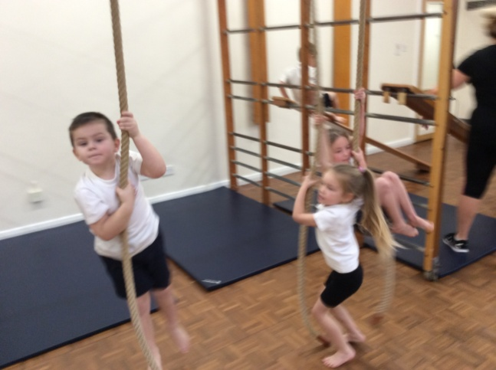
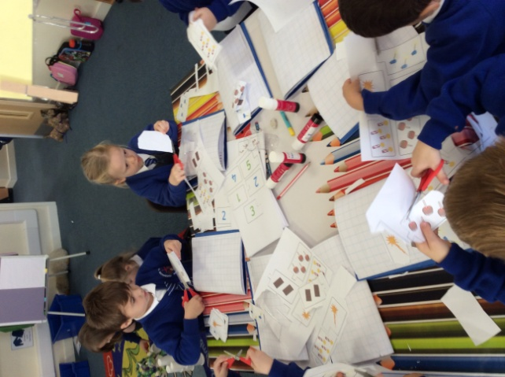
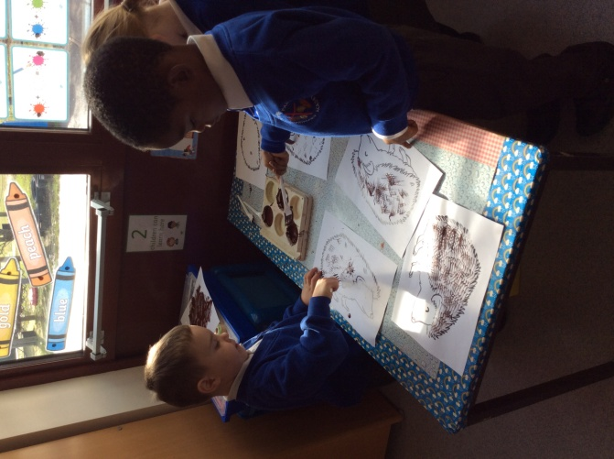
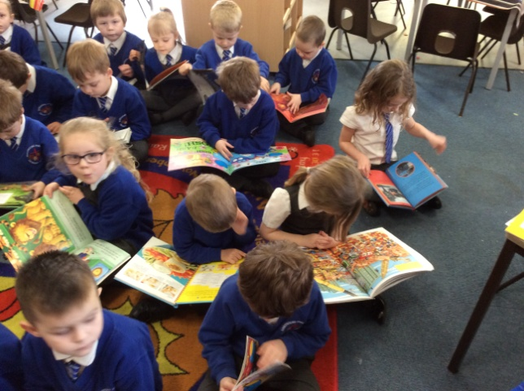
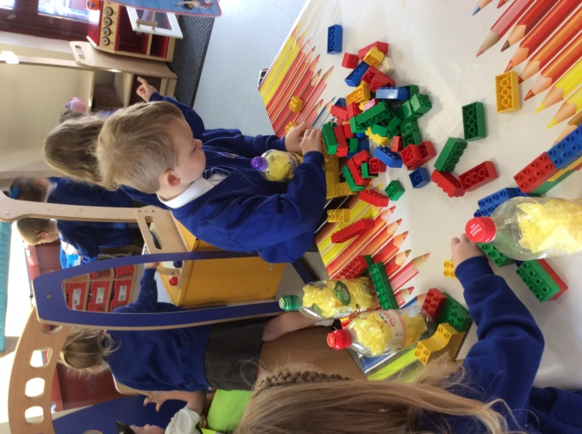
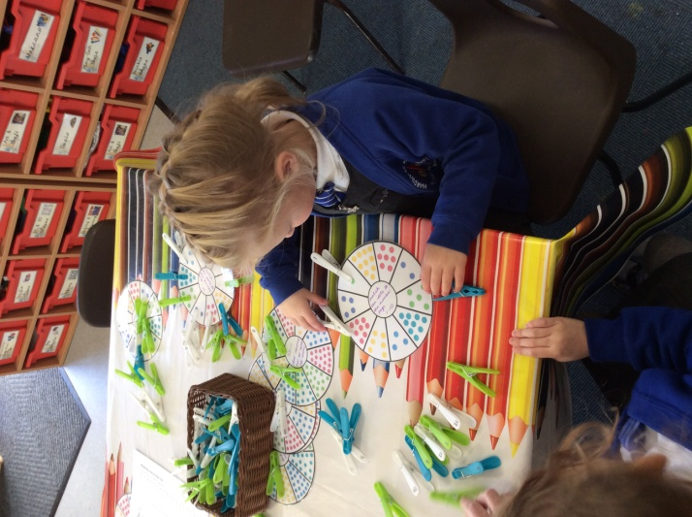
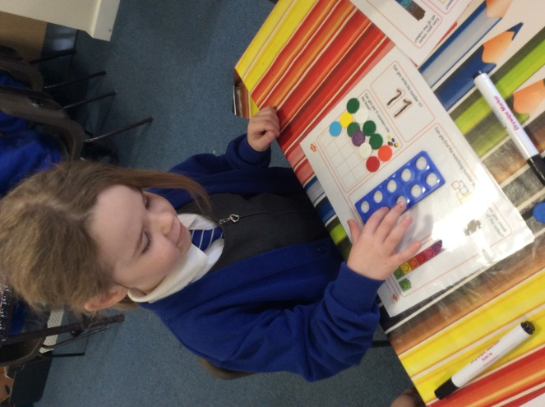
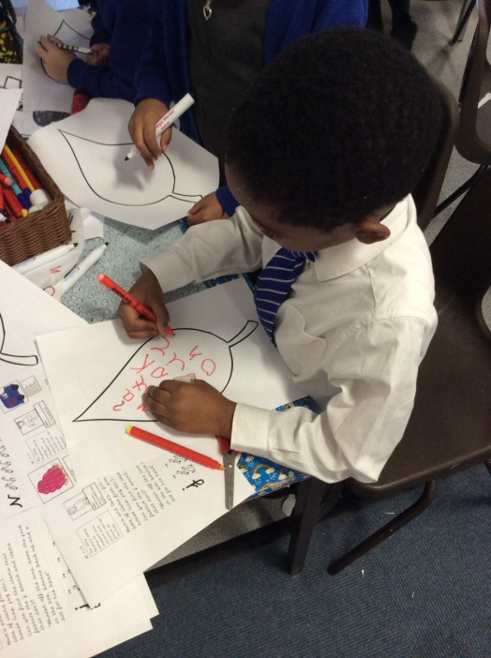
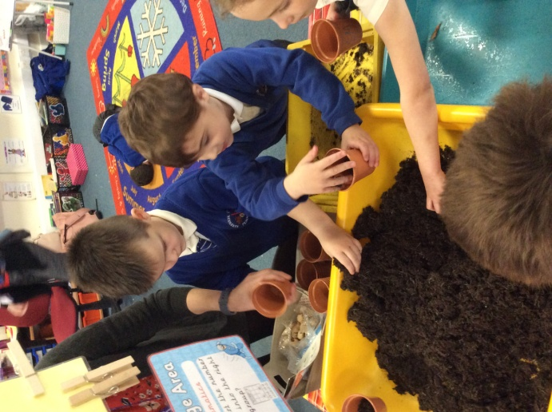
ENGAGEMENT ENJOYMENT ENTHUSIASM = EXCELLENCE
Our Curriculum

Slide 14
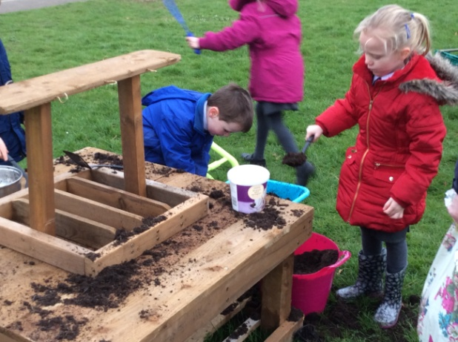
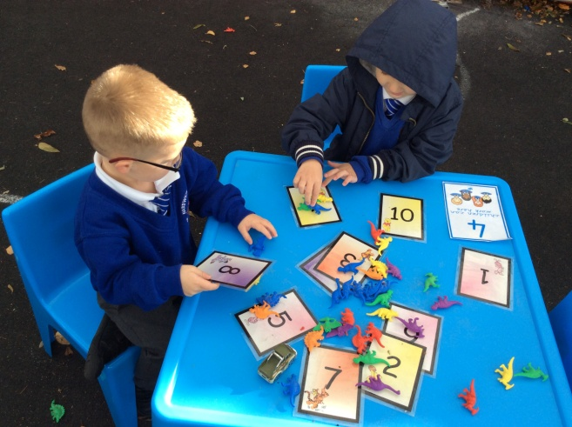
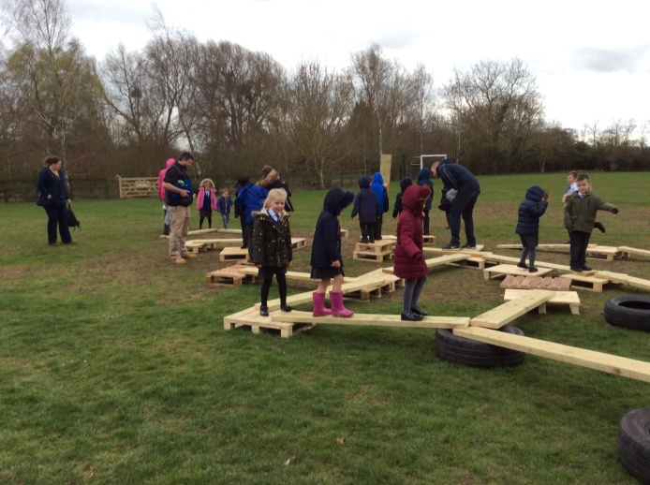
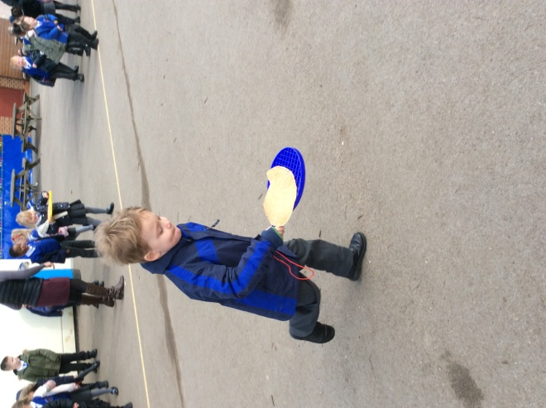
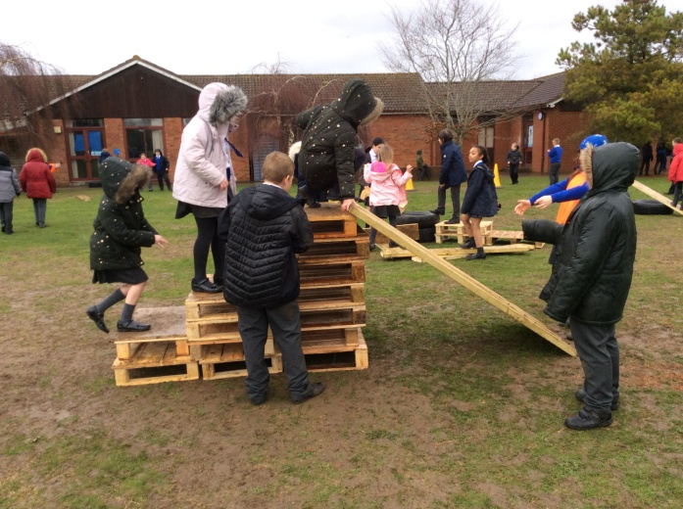
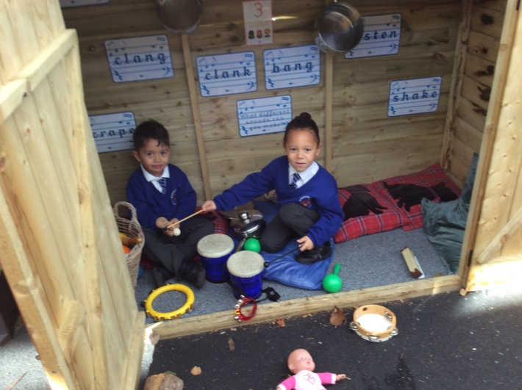
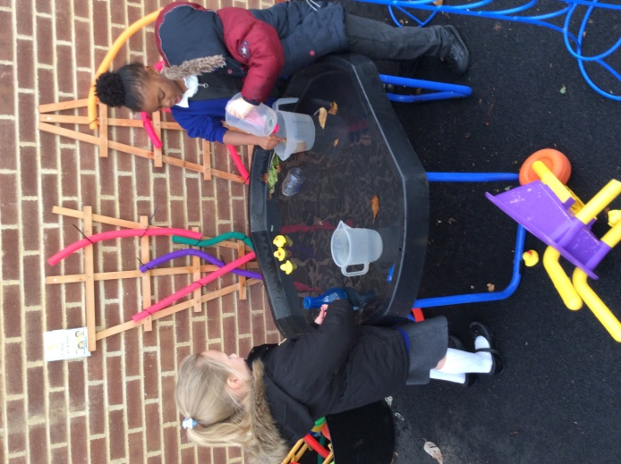
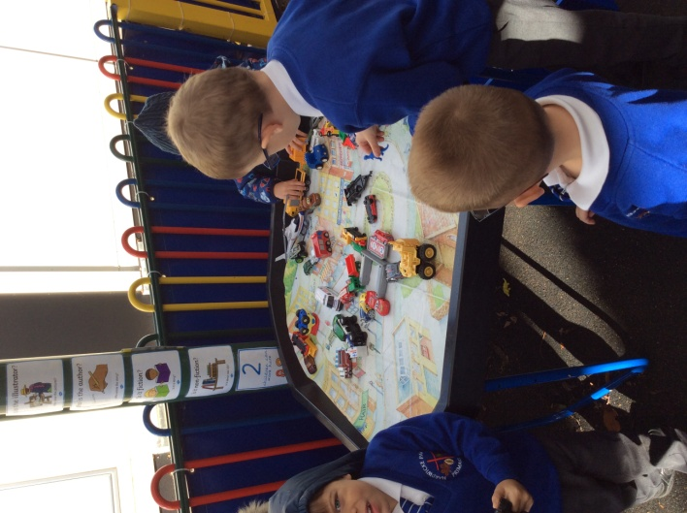
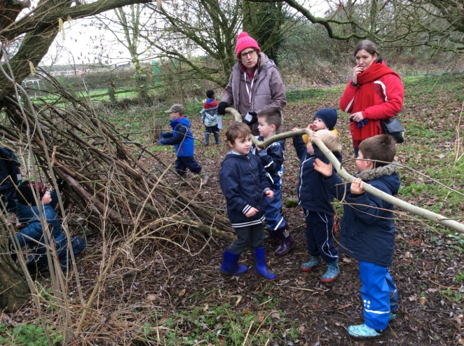
ENGAGEMENT ENJOYMENT ENTHUSIASM = EXCELLENCE
Our Curriculum

Slide 15
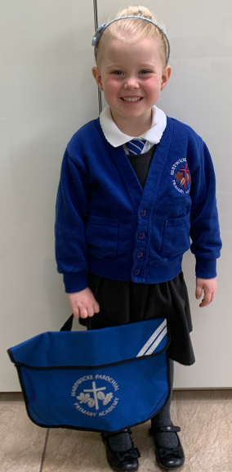
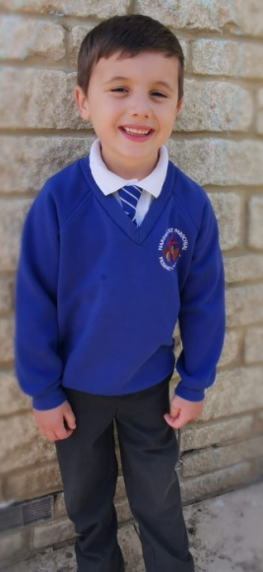
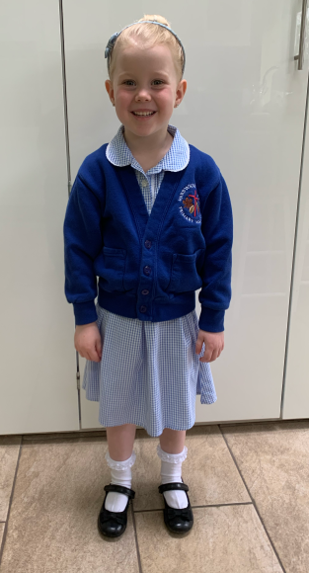
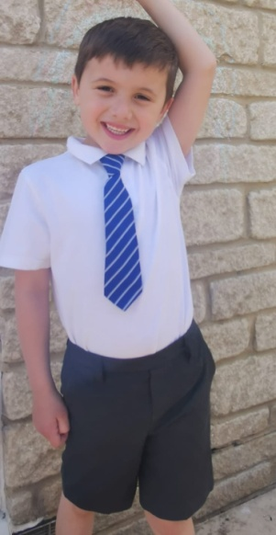
ENGAGEMENT ENJOYMENT ENTHUSIASM = EXCELLENCE
School Uniform
We are very proud of our school uniform-it makes us feel part of one family and gives us our identity.
Our school uniform is available to purchase from the Uniform Shop in Gloucester. (99 Northgate Street – 01452 413339)
PE-PLEASE MAKE SURE YOU NAME EVERYTHING!!
Winter uniform
PE Kit:
Your child will need:
White t-shirt
Black / Royal blue shorts
Daps
PE kits should be left on your child’s peg in a Hardwicke PE Bag available from the Uniform Shop in Gloucester.
Summer uniform

Slide 16
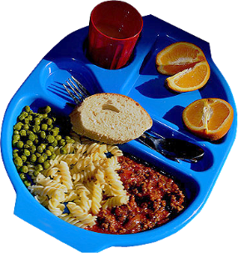
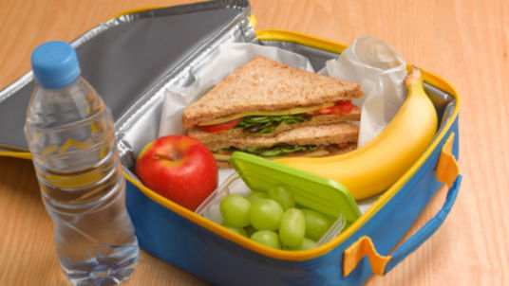
ENGAGEMENT ENJOYMENT ENTHUSIASM = EXCELLENCE
LUNCHTIME
12:00pm – Children go to the hall for either a hot dinner or packed lunch.
Hot dinners – Children line up and are served their dinner which they take to the table
themselves. Children are encouraged to eat within a half hour time frame (some children
take longer and that is fine!) Meals are cooked on site each day and provide the children
with a healthy and balanced dinner. The children have a choice of three different meals
every day – a menu will be sent home to you. To begin with we ask that you make the
choice for your child each day and indicate this by using stickers that we provide you
with.
Packed lunches – We find the children are far happier with a small attractively
presented lunch, e.g. a small sandwich, a few crisps in a container, some grapes and
maybe a small cereal bar. We are a healthy eating school and do not allow
confectionary in lunch boxes. Your child will need a drink but fizzy drinks are strictly
not allowed. All lunch boxes and drink bottles must be clearly named.
12:30pm – Children go to the playground where they partake in OPAL.
12:55pm – The bell is rung for the children to tidy up the games and equipment from OPAL and children
line up.
1:00pm – Staff collect their class from the infant playground and escort them back to class.

Slide 17
ENGAGEMENT ENJOYMENT ENTHUSIASM = EXCELLENCE
SNACK TIME
Snack time is at 10:20am
Each child is offered a free piece of fruit each day so please do not send additional ‘snacks’ into school.
Children will be given their milk or water.
(Please remember to sign up to Cool Milk online where your child will receive free milk up until the term of their 5th birthday. Once your child is five you will need to re-register and pay for your child to receive milk. Please be advised that once you have paid it takes two weeks to show on our list in school.)
All children will have access to water if they prefer. Please send your child into school with a named water bottle. Please ensure it is water as we are a healthy eating school!
Children will sit at their tables with their peers during snack time where we will share a story.

Slide 18
ENGAGEMENT ENJOYMENT ENTHUSIASM = EXCELLENCE
LIMITLESS KIDS
At Hardwicke Parochial Primary Academy, Limitless Kids offer Breakfast Club and After School Club
Limitless Kids provide an Out Of School Club for children from Hardwicke Parochial Primary School. We are OFSTED rated as GOOD and our registered number for Hardwicke is EY495657.
Breakfast Club starts at 8am until school starts
After School Club starts at 3:15pm – 6:15pm
If you would like more information please contact them:
07741 470076 info@limitlesskids.co.uk

Slide 19
ENGAGEMENT ENJOYMENT ENTHUSIASM = EXCELLENCE
ANY QUESTIONS?
No question is a silly question!
Please email your questions to: eyfs@Hardwicke.gloucs.sch.uk

