Slide 1
Hardwicke Parochial Primary School

Slide 2
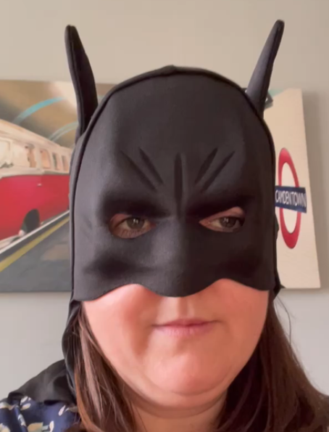
Masked
Reader #1
Ms Bryce

Slide 3
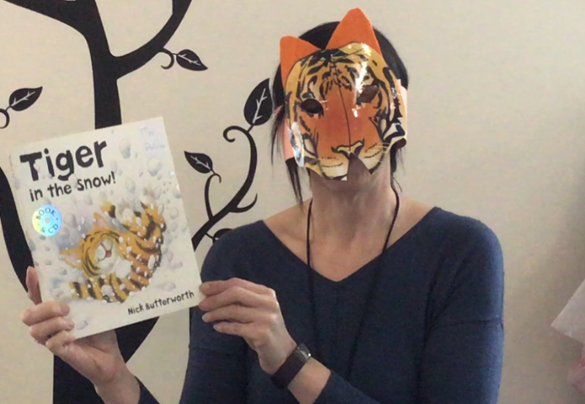
Masked Reader #2
Mrs
Martinger

Slide 4
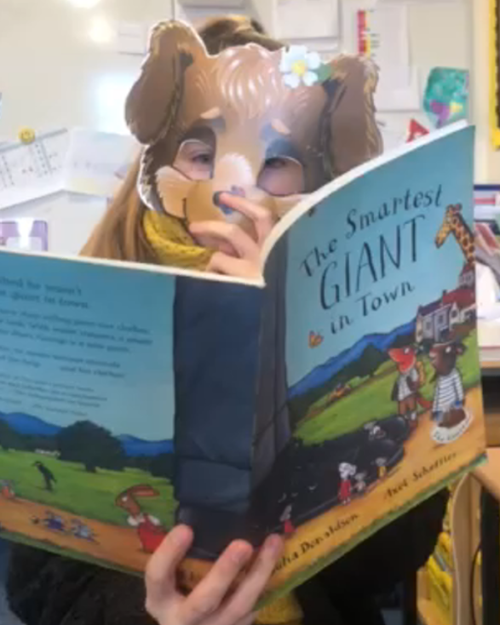
Masked
Reader #3
Miss Rees

Slide 5
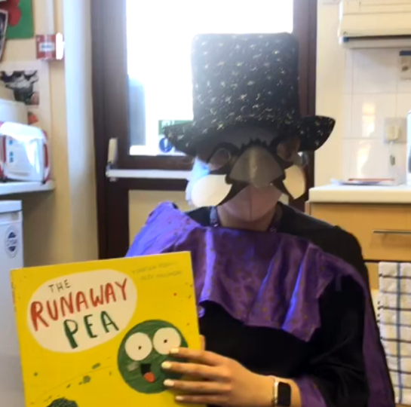
Masked
Reader #4
Miss
Wright

Slide 6
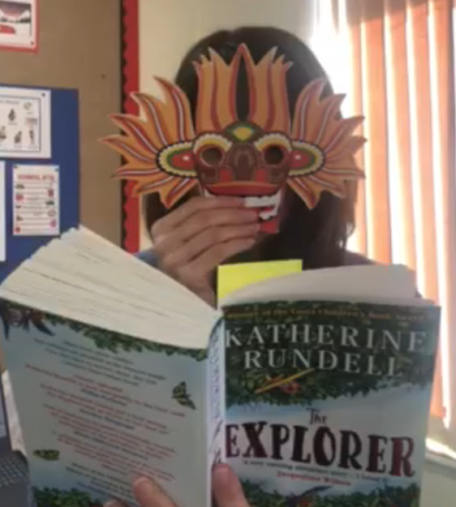
Masked
Reader #5
Mrs
Hathaway

Slide 7
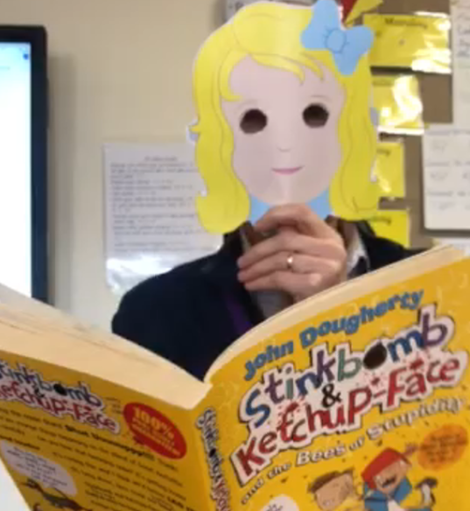
Masked
Reader #6
Mr
Hynes

Slide 8
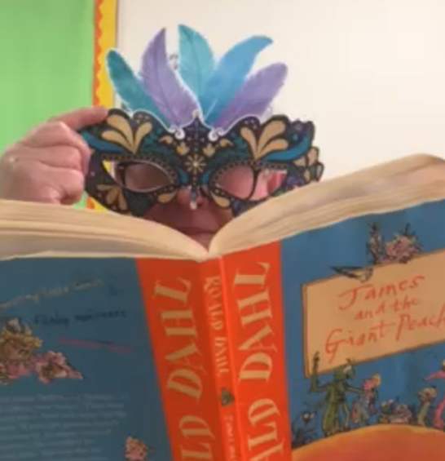
Masked
Reader #7
Mrs
Thomas

Slide 9
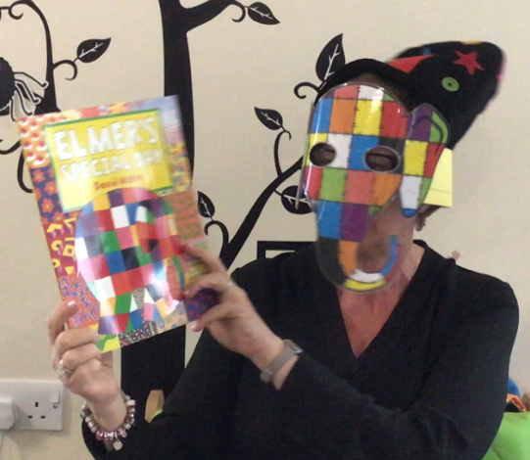
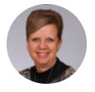
Masked
Reader #8
Mrs
Arinze

Slide 10
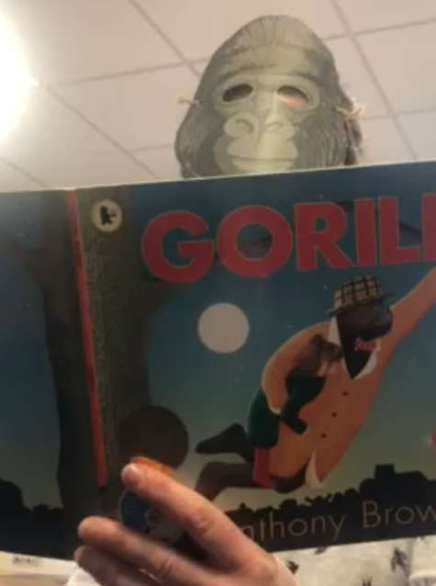
Masked
Reader #9
Miss
Hosking

Slide 11
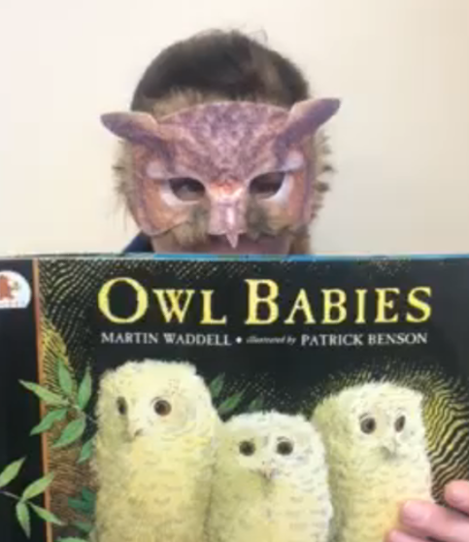
Masked
Reader #10
Mrs
D’Arcy

Slide 12
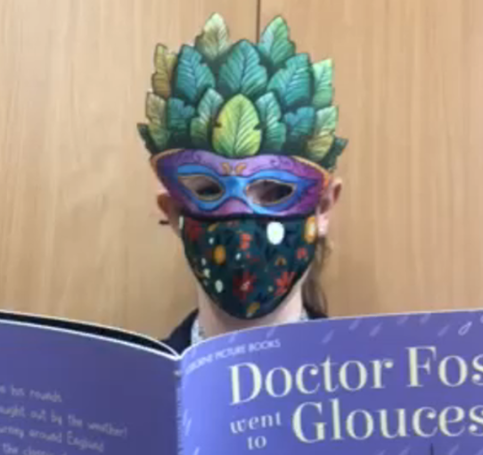
Masked
Reader #11
Mrs
Stancombe

Slide 13
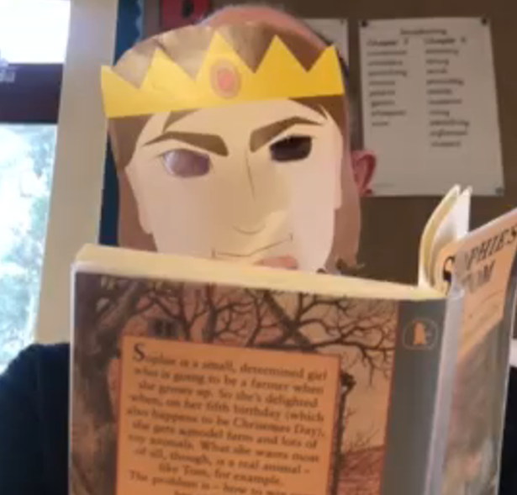
Masked
Reader #12
Mr
Pegg

Slide 14
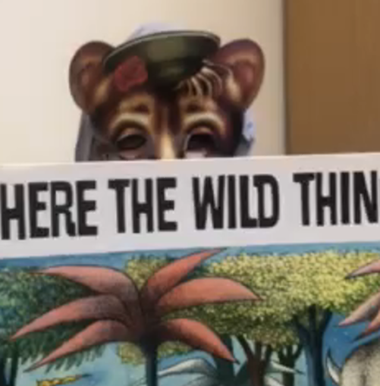
Masked
Reader #13
Mrs
Pitt

Slide 15
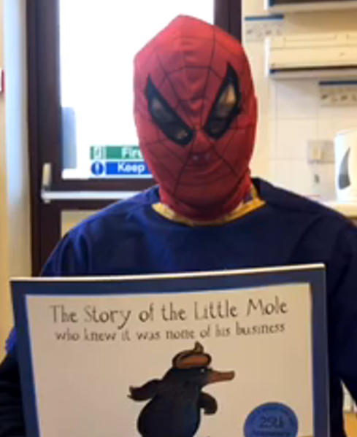
Masked
Reader #14
Mr
Walsh

Slide 16
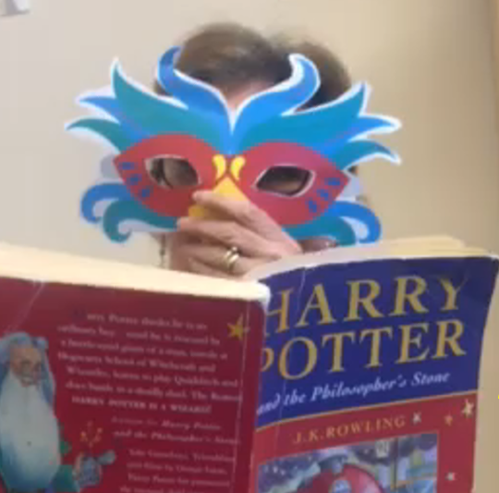
Masked
Reader #15
Mrs
Mitchell-Stead

Slide 17
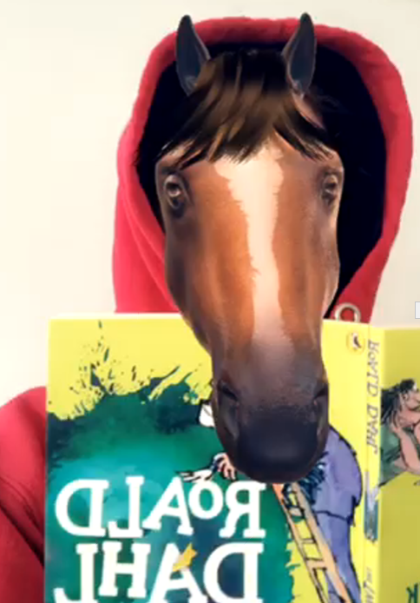
Masked
Reader #16
Miss
Thomas

Slide 18
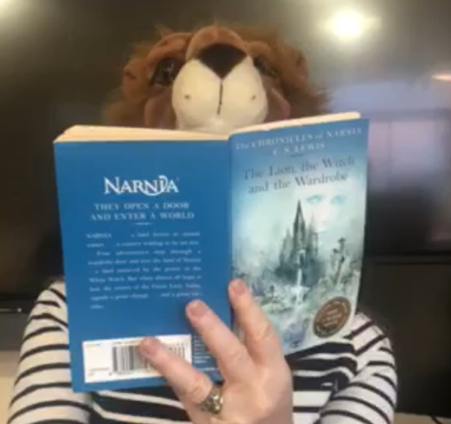
Masked
Reader #17
Mrs
Kerrod

Slide 19
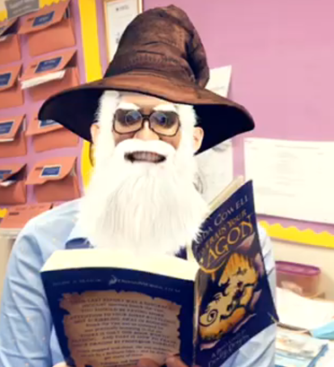
Masked
Reader #18
Mrs
Gregory

